Slide 1
0TH REVIEW PPT A Self-Supervised Behavioral Graph Framework for Zero-Day Cyber Attack Detection with Continual Learning
Phavankumar RL 2022115054
KAVISH S 2022115001
SASHANK GOPALAN 2022115051
SHREYAS S 2022115046
Guided by:
Dr. K. Vidya
Associate Professor
Department of it

Slide 2
AGENDA​
Introduction
Aim
Objective
Problem statement
Literature Survey
Summary of literature survey
Architecture diagram
Modules
References

Slide 3
INTRODUCTION
Zero-day attacks pose a serious challenge to modern cybersecurity because they exploit unknown vulnerabilities and do not match any existing signatures or labeled attack data, rendering traditional rule-based and supervised detection systems ineffective. This project is based on the idea that any successful attack must eventually deviate from normal system behavior, regardless of how novel or sophisticated it is.
Instead of attempting to recognize known attacks, the approach focuses on learning normal behavior directly from unlabeled system activity and identifying deviations as potential threats. By adopting a behavior centric and self supervised learning strategy, the project aims to detect previously unseen zero day attacks while remaining adaptive, reliable, and suitable for real world cybersecurity environments.

Slide 4
OBJECTIVE
To learn and model normal system behavior directly from unlabeled operational data using a behavior centric and self supervised learning approach.
To detect previously unseen zero day attacks by identifying deviations from learned normal behavior rather than relying on predefined signatures or attack labels.
To capture complex and multi stage attack patterns by representing system activity through behavioral relationships and interactions.
To adapt continuously to evolving system behavior and emerging threats while preserving previously acquired knowledge.
To generate reliable and interpretable security alerts that support effective decision making in real world cybersecurity environments.

Slide 5
Problem statement
Zero-day attacks exploit previously unknown vulnerabilities and operate without identifiable signatures, making them extremely difficult to detect using traditional security mechanisms. Most existing intrusion detection systems rely on predefined rules, known attack patterns, or supervised learning models trained on historical datasets. These approaches fail to generalize to unseen threats and often produce high false positive rates when deployed in dynamic real world environments, limiting their effectiveness against evolving attack strategies.
There is a need for an intelligent detection approach that does not depend on prior knowledge of attacks but instead understands and models normal system behavior to identify malicious deviations. Such a system must be capable of learning from unlabeled data, adapting continuously to changing system dynamics, and detecting complex multi stage attack behavior while maintaining reliability and interpretability. Addressing these challenges forms the core problem addressed by this project.

Slide 6
Paper Title / Publisher / Year | Problem Statement | Methodology | Pros | Cons
An Intrusion Detection Model to Detect Zero-Day Attacks in Unseen Data Using Machine Learning, 2025 | Existing intrusion detection systems struggle to detect zero-day attacks because they rely on known patterns and labeled data, leading to poor generalization on unseen threats. | An autoencoder is trained on normal data to perform anomaly detection, and its reconstruction error is combined with Random Forest and XGBoost classifiers to improve detection on unseen data. | High accuracy on unseen data, effective anomaly detection, strong performance on benchmark datasets. | Relies on handcrafted features, limited behavioral relationship modeling, high computational cost, lacks continual learning capability.

Slide 7
Paper Title / Publisher / Year | Problem Statement | Methodology | Pros | Cons
Analysis of Continual Learning Models for Intrusion Detection Systems, 2025 Publisher: IEEE Access | Deep learning based intrusion detection systems suffer from catastrophic forgetting when trained on evolving network data, making them ineffective against zero day attacks and covariate shifts in real world environments. | The paper proposes an eight stage framework to detect data distribution drift and evaluates multiple continual learning strategies such as learning without forgetting, experience replay, and dark experience replay on NSL KDD and CICIDS 2017 datasets. | Addresses catastrophic forgetting, supports incremental learning, evaluates online deployment scenarios, strong experimental validation on benchmark datasets. | Relies on tabular feature based data, does not model behavioral relationships explicitly, limited focus on graph based representations or self supervised learning.

Slide 8
Paper Title / Publisher / Year | Problem Statement | Methodology | Pros | Cons
Continual Learning for Intrusion Detection Under Evolving Network Threats, 2025 Publisher: MDPI, Future Internet | Traditional intrusion detection systems fail in real world environments due to catastrophic forgetting, scarcity of labeled data, and severe class imbalance as new attack types continuously emerge. Static models degrade over time and struggle to retain knowledge of previously seen threats while learning new ones. | The paper proposes a semi supervised continual learning framework that integrates dynamic memory selection using clustering, multi level knowledge distillation across logits, attention, and feature spaces, and meta learning based dynamic class reweighting to adapt to evolving and imbalanced network traffic distributions. | Effectively mitigates catastrophic forgetting, supports long term deployment, leverages unlabeled data, handles class imbalance well, and demonstrates strong performance on real world intrusion datasets | Relies on tabular traffic features, does not explicitly model system level behavioral relationships, limited focus on behavior graphs or interaction based representations, and focuses more on network traffic than host level behavior..

Slide 9
Paper Title / Publisher / Year | Problem Statement | Methodology | Pros | Cons
Enhancing Cybersecurity: Zero-Day Attack Detection in Network Traffic with Deep Learning Model, 2025 Publisher: Asian Journal of Research in Computer Science | Signature-based intrusion detection systems fail to identify zero-day attacks because such attacks exploit previously unknown vulnerabilities and exhibit unseen behavior in network traffic. Existing machine learning approaches struggle to generalize effectively to these unknown threats. | The paper proposes a deep learning based zero-day detection framework using a Convolutional Neural Network trained on the UNSW-NB15 dataset. The approach includes data preprocessing, normalization, one-hot encoding, class balancing using SMOTE, feature selection using the VFS algorithm, and CNN-based classification of network traffic. | High detection accuracy for zero-day attacks, strong performance on real-world benchmark datasets, effective feature selection and class balancing, and superior results compared to traditional ML models such as SVM and Random Forest. | Relies on supervised learning with labeled attack data, limited ability to detect completely unseen attack behaviors, operates on flat network traffic features without explicit behavioral or relational modeling, and lacks continual learning or long-term adaptability.

Slide 10
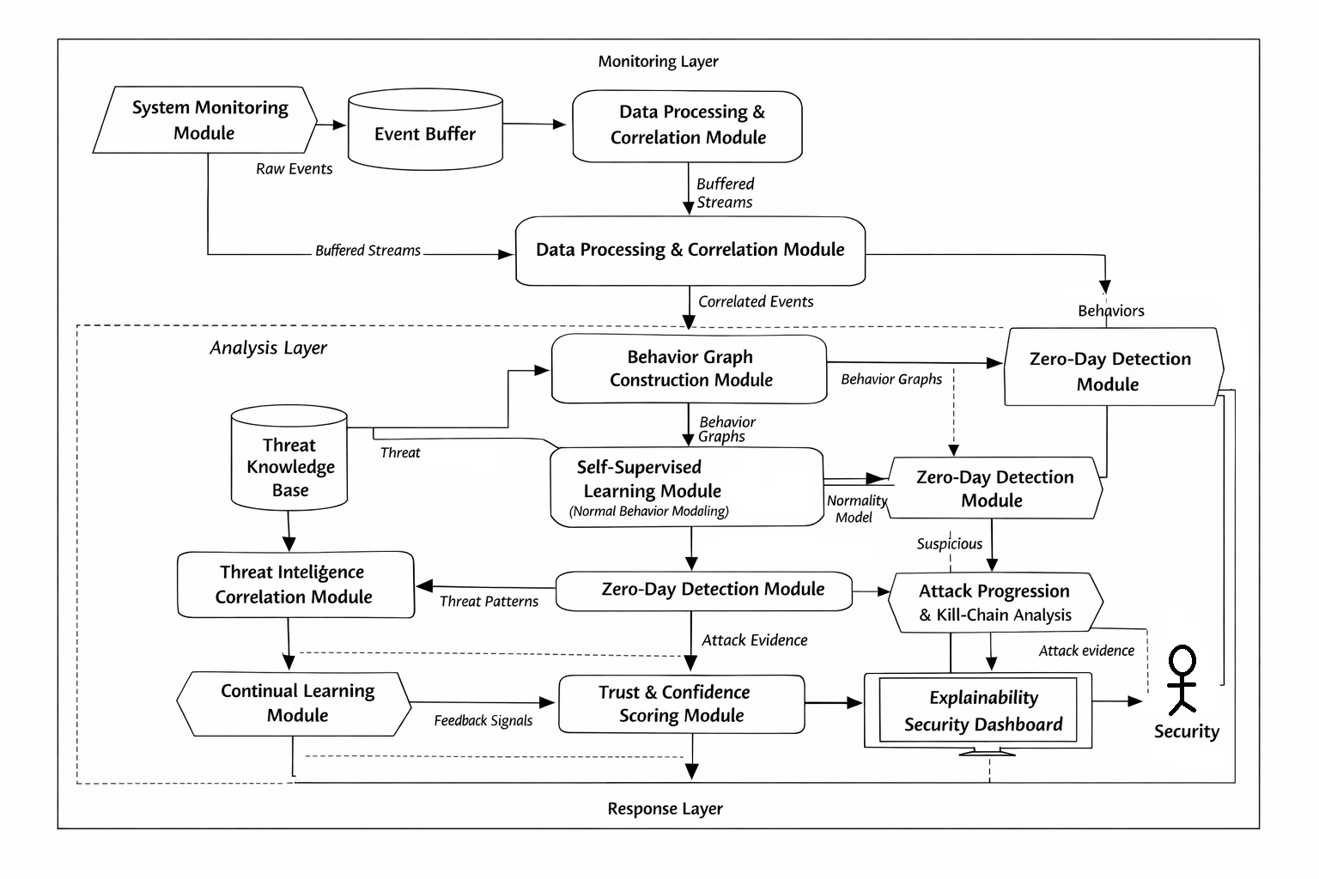

Slide 11
Module wise description
Module 1: System Monitoring Module
This module continuously observes low-level system activity without interfering with normal operations.
It monitors processes, file accesses, network connections, and system-level actions generated during regular computer usage.
The objective is to collect raw behavioral evidence rather than classify or block activities at this stage.
This ensures that both benign and potentially malicious behaviors are captured in their natural form.

Slide 12
Module 2: Event Buffering and Data Collection Module
Raw system events occur at very high frequency and cannot be processed instantaneously.
This module temporarily stores incoming events in a buffer to ensure no behavioral information is lost.
It enables controlled, sequential processing of events and prevents overload in later stages.
Buffered data preserves the original order and timing of events, which is essential for behavioral analysis.
Module 3: Data Processing and Correlation Module
Raw system events are noisy, fragmented, and difficult to interpret individually.
This module filters irrelevant events, removes redundancy, and groups related actions based on temporal proximity.
Multiple low-level events are correlated to form meaningful behavioral sequences.
As a result, isolated system actions are transformed into coherent activity patterns.

Slide 13
Module 4: Behavior Graph Construction Module
Instead of representing system activity as flat numerical records, this module models behavior as graphs.
System entities such as processes, files, and network endpoints are represented as nodes, while interactions are represented as edges.
This graph-based representation captures relationships and dependencies between system components.
Modeling behavior in this relational form allows the system to detect complex and multi-stage attack patterns.
Module 5: Behavior Graph Repository
Generated behavior graphs are stored in a dedicated repository for further analysis and learning.
This module supports efficient retrieval of historical behavioral patterns for comparison and training.
Storing graph snapshots enables temporal analysis and long-term behavioral tracking.
It also supports incremental updates required for continual learning.

Slide 14
Module 6: Graph Feature Encoding Module
Raw graphs cannot be directly processed by learning algorithms.
This module converts graph structures into numerical representations while preserving relational information.
Structural patterns, interaction strengths, and temporal properties are encoded into feature vectors.
These encoded representations serve as inputs to the learning models.
Module 7: Self-Supervised Learning Module
This module learns normal system behavior without using labeled attack data.
It is trained exclusively on benign operational data using self-supervised objectives.
The model learns to recognize typical behavioral patterns and interactions present in normal system operation.
By learning normality instead of attack signatures, the system becomes capable of detecting unseen zero-day attacks.

Slide 15
Module 8: Zero-Day Detection and Anomaly Scoring Module
Incoming behavioral representations are compared against the learned normal behavior model.
Deviations from normal patterns are quantified using anomaly or deviation scores.
High deviation scores indicate behavior that does not conform to expected system operation.
Such behavior is flagged as a potential zero-day attack without relying on prior attack knowledge.
Module 9: Attack Progression and Kill-Chain Analysis Module
Cyber attacks often occur as sequences of actions rather than single anomalous events.
This module analyzes how suspicious behaviors evolve over time.
It identifies multi-stage attack patterns such as initial access, privilege escalation, and data exfiltration.
Viewing attacks as behavioral sequences reduces false positives and improves detection reliability.

Slide 16
Module 10: Threat Intelligence Correlation Module
Detected suspicious behavior is cross-checked against known attack tactics and behavioral patterns.
This module does not rely on exact signatures but compares high-level behavioral characteristics.
Correlation with known threat strategies adds contextual validation to detected anomalies.
This step increases confidence in detection and reduces unnecessary alerts.
Module 11: Trust and Confidence Scoring Module
Instead of producing binary decisions, this module assigns a confidence score to each detection.
The score is computed by combining anomaly severity, attack progression evidence, and threat correlation results.
This mirrors real-world security operations where alerts are prioritized based on risk levels.
Confidence scoring enables informed and proportional response decisions.

Slide 17
Module 12: Continual Learning Module
System behavior and attack strategies evolve over time, causing static models to degrade.
This module incrementally updates the learning model using new behavioral information.
It incorporates new knowledge while preserving previously learned behavior patterns.
This prevents catastrophic forgetting and ensures long-term effectiveness.
Module 13: Explainable Security Dashboard
Detection results are presented in an interpretable and human-readable format.
This module visualizes behavioral graphs, attack timelines, and confidence scores.
It explains why a particular behavior was flagged as suspicious.
Human analysts can understand, verify, and trust the system’s decisions.

